Slide 1
TRANSFORM
Transforming Future by MIT and Tangible Media Group

Slide 2

TRANSFORM

Slide 3


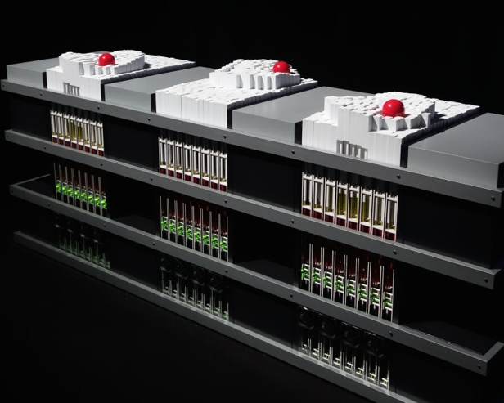
TRANSFORM
TRANSFORM fuses technology and design to celebrate its transformation from a piece of still furniture to a dynamic machine driven by the stream of data and energy.
Created by Professor Hiroshi Ishii and the Tangible Media Group from the MIT Media Lab, TRANSFORM aims to inspire viewers with unexpected transformations, as well as the aesthetics of the complex machine in motion.

Slide 4
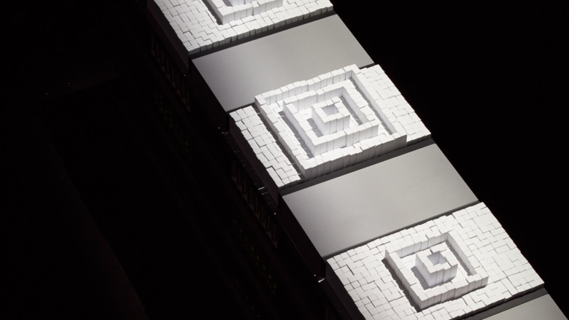
TRANFORM WORKING
The work is comprised of three dynamic shape displays that move more than one thousand pins up and down in real-time to transform the tabletop into a dynamic tangible display.
The kinetic energy of the viewers, captured by a sensor, drives the wave motion represented by the dynamic pins.
These pins are made up of light weight fibrous plastic that makes them unbreakable and also easily movable by the hydraulics.

Slide 5

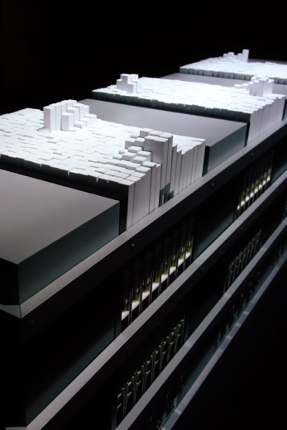
Major TRANSFORM Uses
It serves many purpose one of the major purpose being a dynamic table which changes it shape and usage according to user preferences.
It acts as a temporary 3D builder decreasing the amount of other devices used on a table like pen stand, tablet stands etc.
Its real-time changes enables it to be accessed from different location just like cloud.
Other than being a multi functional table it is also a beautiful and a sturdy table.

Slide 6
Future Possibilities for TRANFORM
Cheaper and faster temporary 3D.
It can collaborate with phone and can help in making 3D projector screen.
Its Nano scale can make it easily portable, small and can replace many furniture which can be changed in a house or an office.

